Slide 1

Quickneed: Campus Sharing Simplified
Quickneed is revolutionizing student resource exchange with a secure, university-exclusive borrowing platform. It leverages technology to connect students, making sharing easy and safe within the campus community.
YB
Notes:
‹#›

Slide 2




Addressing Campus Resource Challenges
High Costs
Unreliable Networks
Students often struggle with the high costs of purchasing items needed only temporarily.
Finding reliable borrowing networks can be difficult and untrustworthy for many students.
Limited Safe Options
There's a lack of trusted, safe sharing platforms within the university community.
Notes:
‹#›

Slide 3
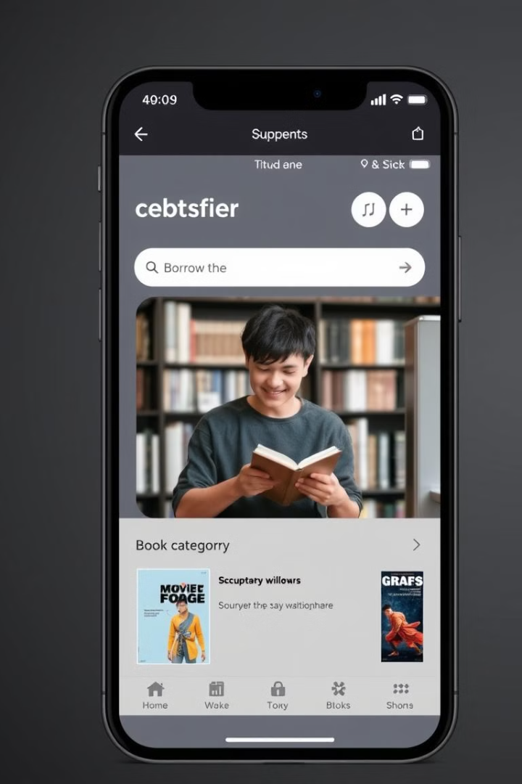




How Quickneed Simplifies Sharing
University Email Access
Exclusive access is granted with university email verification for security.
Comprehensive Filtering
A robust product filtering system helps students find items quickly and efficiently.
Real-Time Communication
Real-time chat facilitates easy communication about item specifics.
Notes:
‹#›

Slide 4

Prioritizing Safety and Trust
Email Authentication
User Verification
University email authentication ensures that only verified students can access the platform.
A thorough user verification process adds an extra layer of security and trust.
Communication Tracking
All in-app communication is tracked, providing a safe environment for interactions.
Notes:
‹#›

Slide 5
Efficient Product Filtering & Discovery
Categorization
Transparent History
Items are categorized by type, condition, and availability.
Transparent item history and user ratings help make informed decisions.
Advanced Search by Location, Borrowing duration.
Notes:
‹#›

Slide 6




Streamlined Communication & Exchange
Integrated Chat
Utilize the integrated chat for easy communication.
Scheduling
Coordinate schedules and meetups effortlessly.
Feedback
Share feedback and ratings to improve the community.
Notes:
‹#›

Slide 7



Unlock User Benefits with Quickneed
1
Save Money
2
Reduce Waste
3
Build Community
Quickneed users save money, reduce waste through collaborative consumption, and build campus community connections via a user-friendly mobile experience.
Notes:
‹#›

Slide 8

Transforming Campus Sharing
100%
50%
Sustainable
Cost-Effective
Future of resource sharing in educational communities.
A cost-effective solution for all students.
100K+
Empowering
Empowering students through technology.
Notes:
‹#›

